Slide 1
Core java
NEEHARIKA

Slide 2
INTERFACES

Slide 3
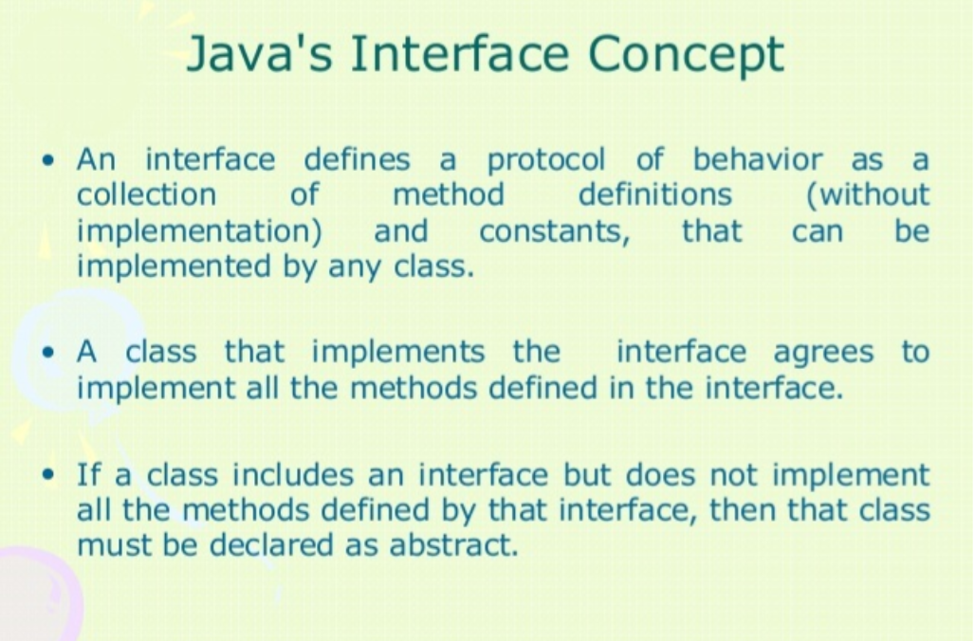

Slide 4
WHY USE JAVA INTERFACE

Slide 5
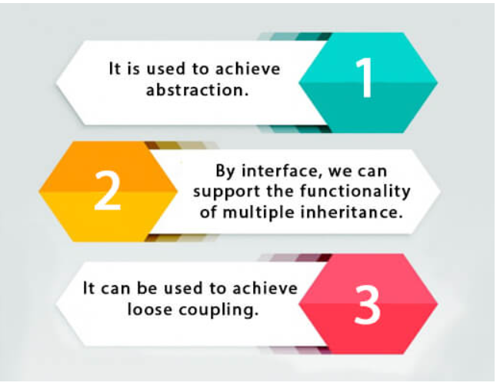

Slide 6
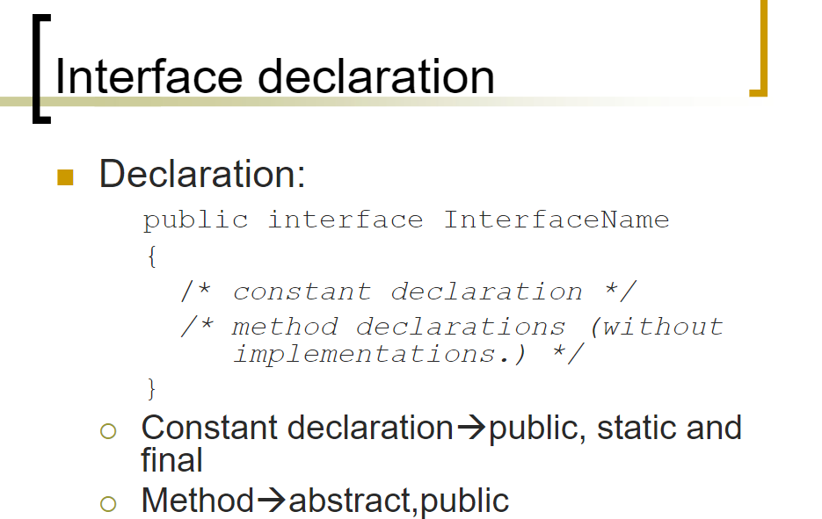

Slide 7
THE RELATIONSHIP BETWEEN CLASSES AND INTERFACES

Slide 8
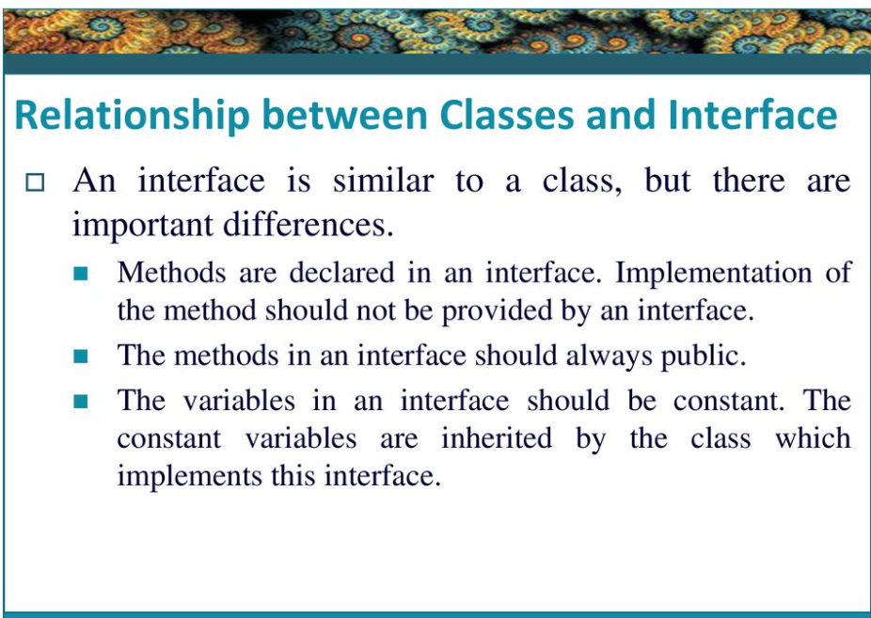

Slide 9
INTERFACE DECLARATION

Slide 10
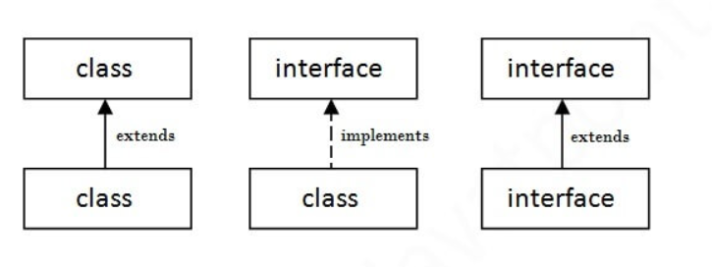

Slide 11
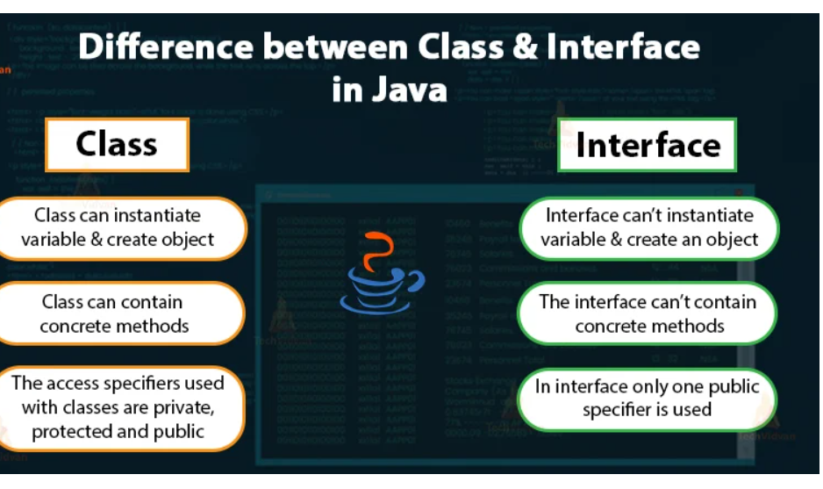

Slide 12
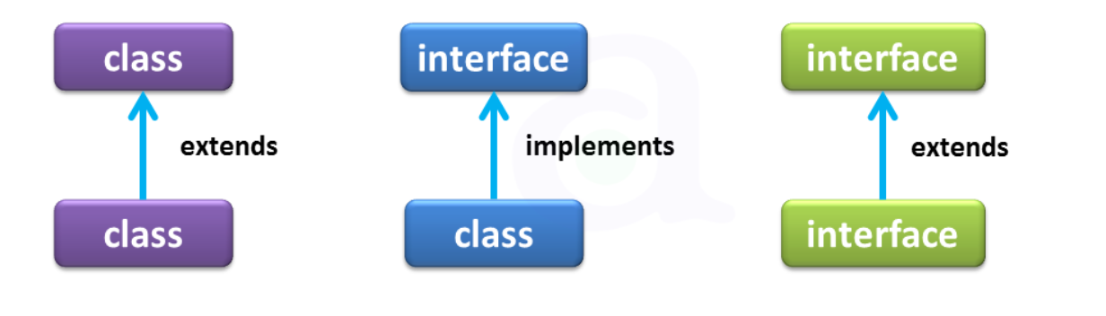

Slide 13
Multiple inheritance in Java by interface

Slide 14
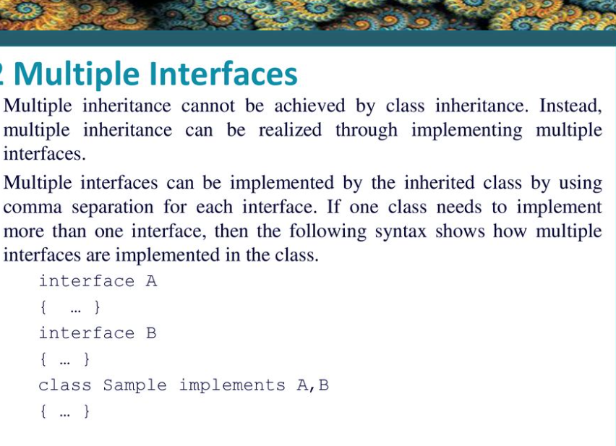

Slide 15
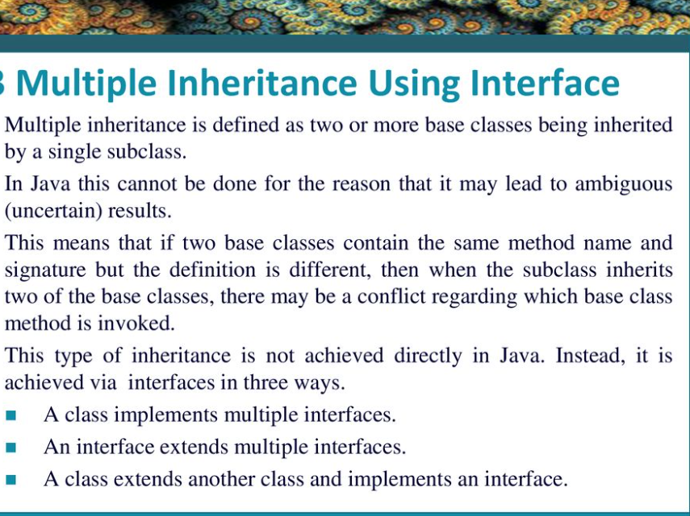

Slide 16
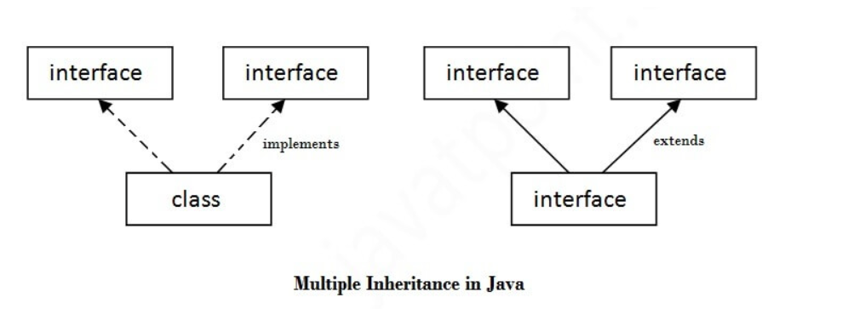

Slide 17
INTERFACE INHERITANCE

Slide 18
DEFAULT METHOD IN INTERFACE

Slide 19
MARKER OR TAGGED INTERFACE

Slide 20
NESTED INTERFACE IN JAVA

Slide 21
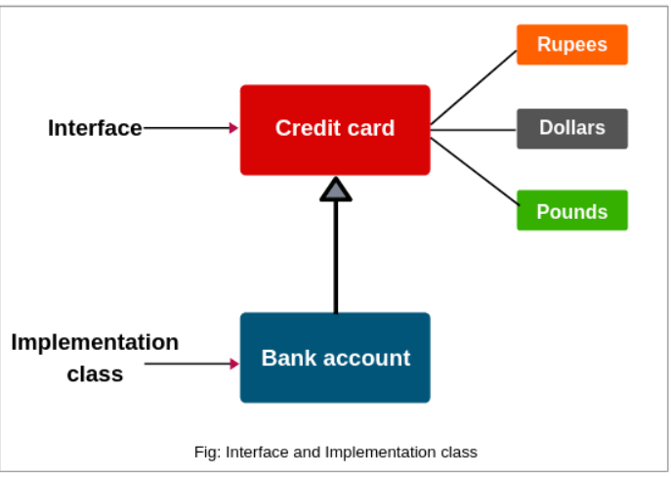

Slide 22
JAVA PACKAGE

Slide 23
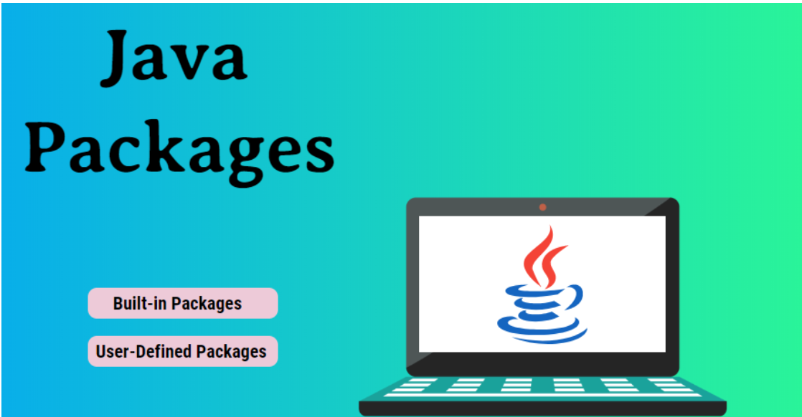

Slide 24
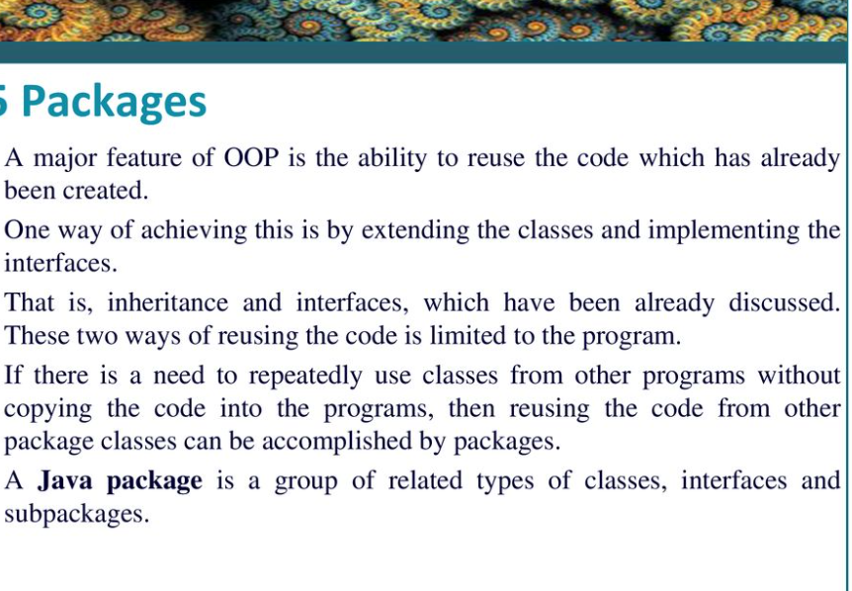

Slide 25
Advantage of Java Package
Java package is used to categorize the classes and interfaces so that they can be easily maintained.
2) Jage provides access protectionava pack.
3) Java package removes naming collision.

Slide 26
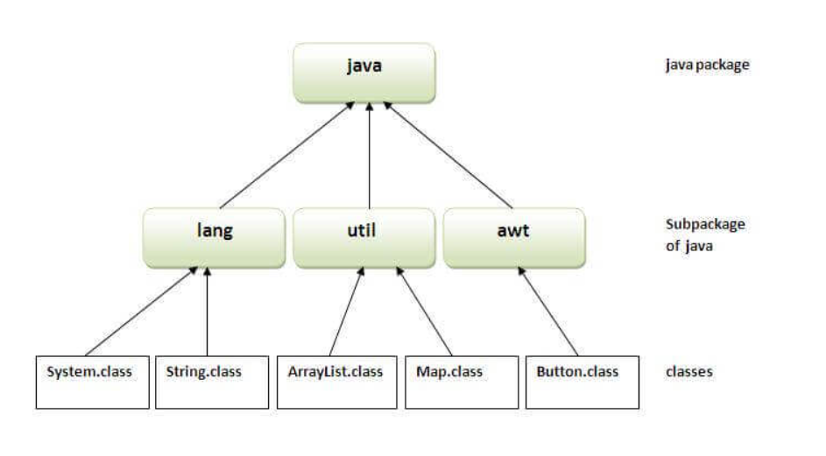

Slide 27
How to access package from another package?

Slide 28
Using packagename

Slide 29
Using packagename.classname

Slide 30
USING FULLY QUALIFIED NAME

Slide 31
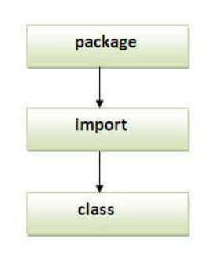

Slide 32
Subpackage in java

Slide 33
How to send the class file to another directory or drive?

Slide 34
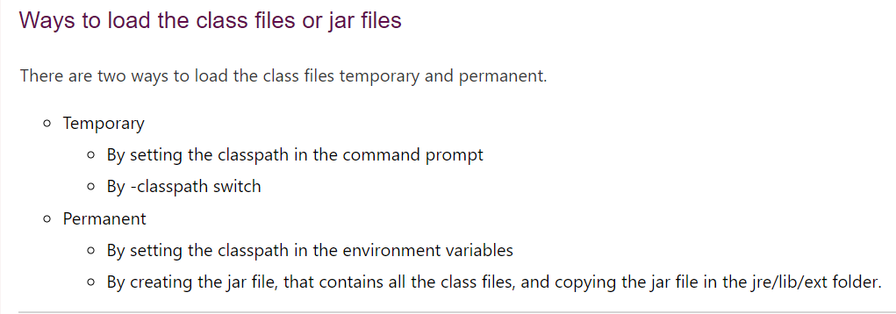

Slide 35
PACKAGE CLASS

Slide 36
Access Modifiers in Java

Slide 37
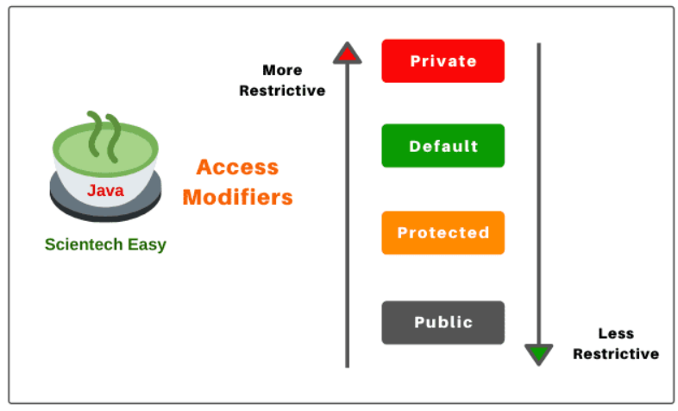

Slide 38
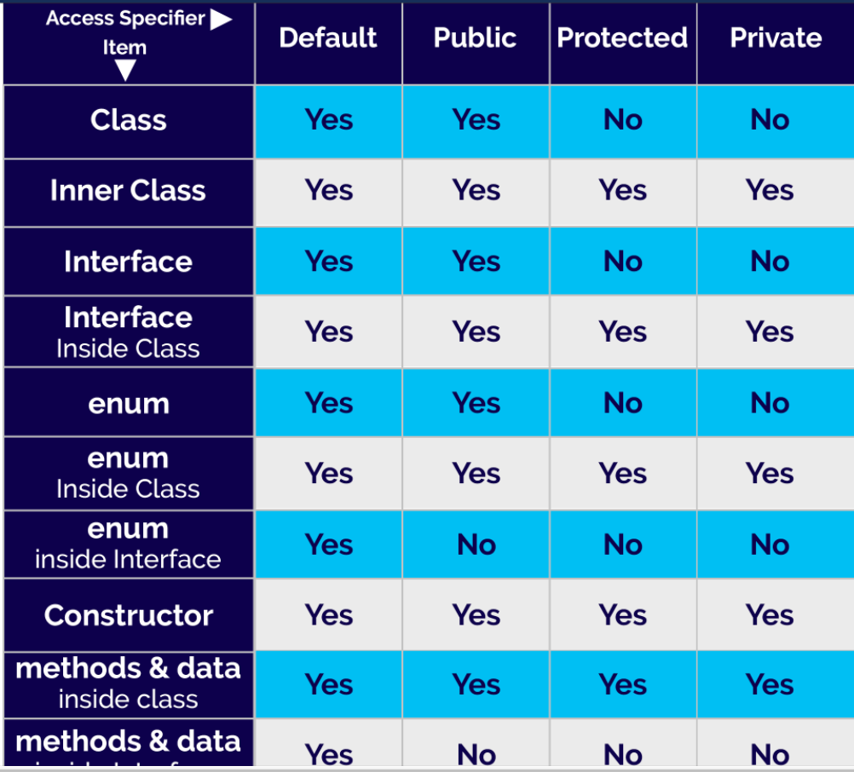

Slide 39
Thank you

